Slide 1
PostgreSQL

Slide 2
PostgreSQL
Evolved from project Ingres at UC, Berkeley
Originally titled Postgres
Renamed PostgreSQL in '96
Developed by PostgreSQL Global Development Group
Free and open-source

Slide 3
PostgresSQL
Database An organized collection of data
Has a database model
Is managed by a Database Management System

Slide 4
PostgresSQL
Database Management System
● Application that manages the creation, querying, update, and administration of databases
● Supports particular logical and physical data models
● Allows users to create/manipulate data/information while taking care of the underlying data structures

Slide 5
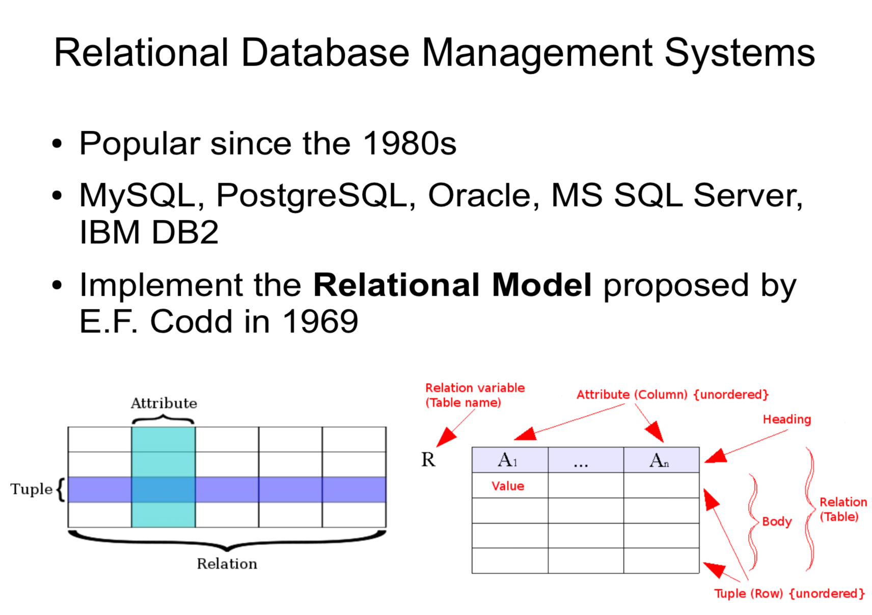

Slide 6
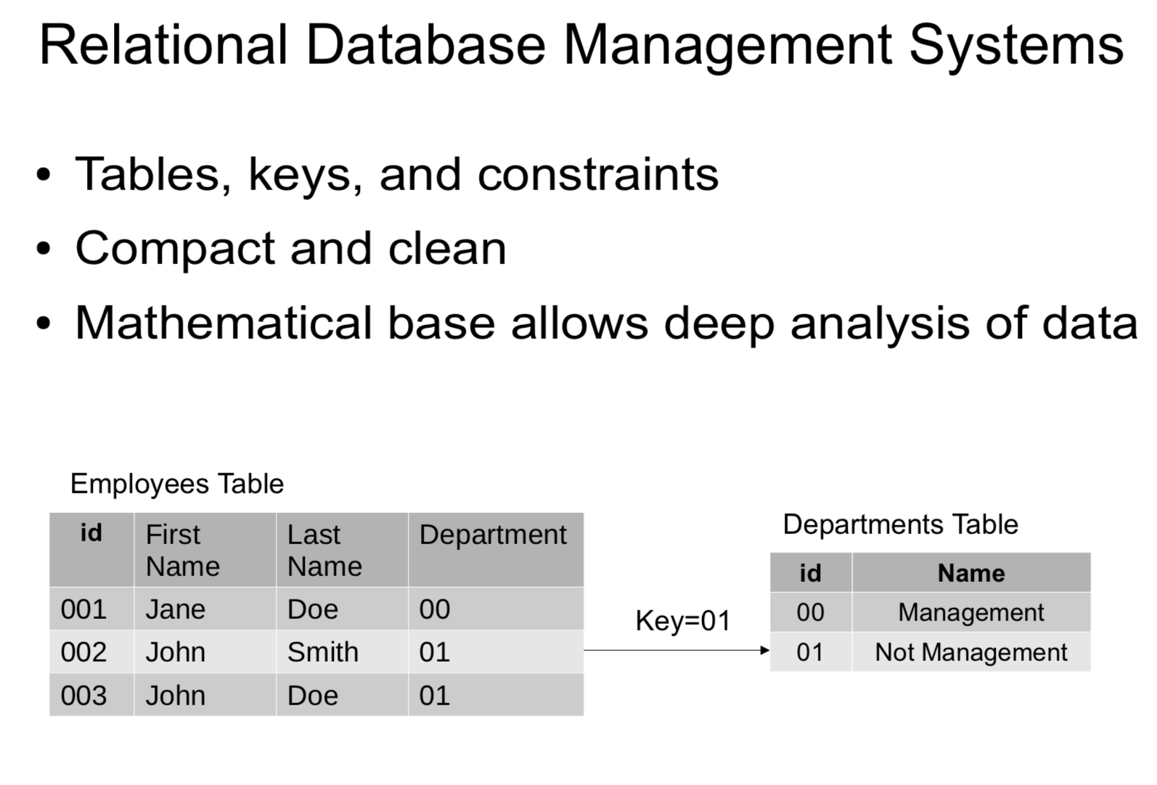

Slide 7
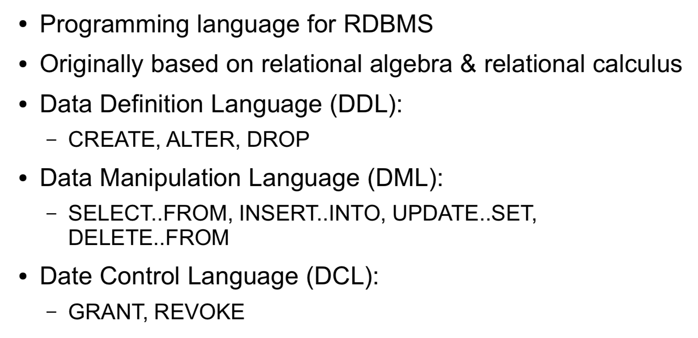
Structured Query Language (SQL)

Slide 8
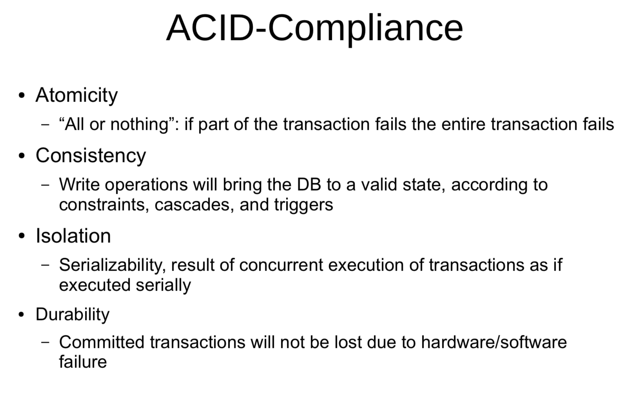

Slide 9
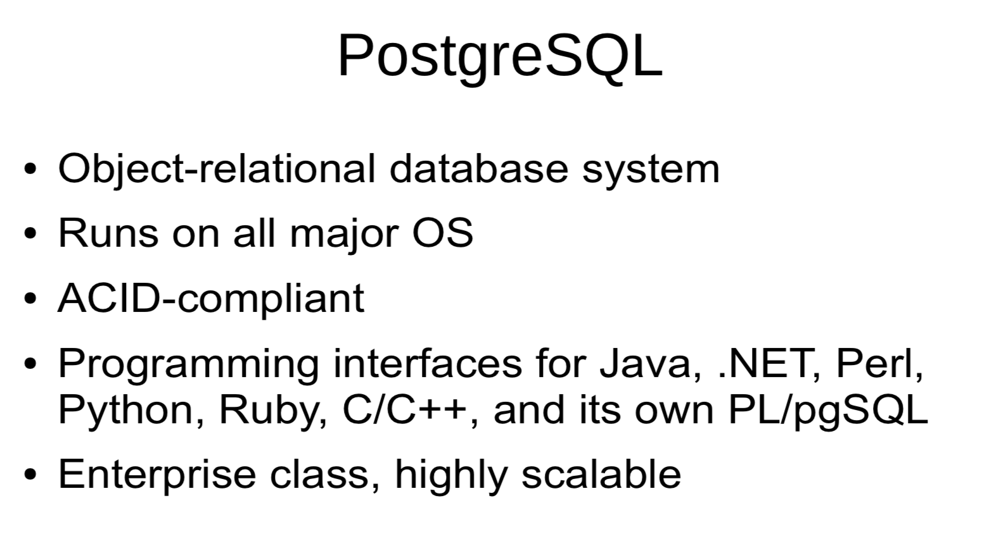

Slide 10
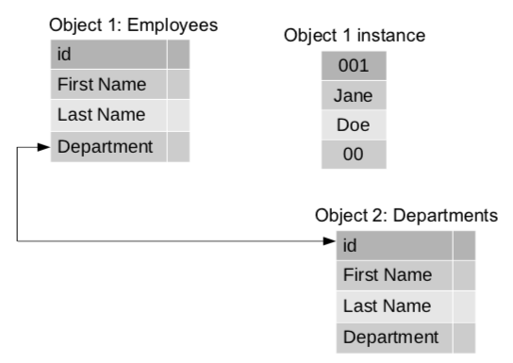
Object-relational DBMS
Database model is hybrid of relational model and object-oriented model

Slide 11
Why Object-relational ?
Relational Database:
- Mathematical relation allows set theory techniques in data analysis
Object-oriented Database: Allows sets, lists, user-defined datatypes and nested objects
ORDBMS bridge the gap
It can handle complex data, nested objects, type inheritance

Slide 12
PostgreSQL: Type Inheritance
Tables can inherit from parent tables
Data in child tables will appear as if they exist in parent tables
Can be used for data partitioning
- e.g. Separate tables for monthly sales data
- Easier maintenance
- Smaller tables with smaller indexes mean faster searches

Slide 13
PostgreSQL: Supported Datatypes
Native datatypes:
- Boolean, Character, Binary, Date/Time, bigint, integer, double precision, XML, JSON, IPv4, IPv6 addresses, MAC addresses
User-defined datatypes:
– Complex objects, domains, ranges, geometric types such as points, lineStrings, Polygons

Slide 14
PostgreSQL: Extensibility
Open-source with permissive free-software license
Programming interfaces for C/C++, Java, .NET, Perl, Python, ODBC,...
Stored procedures can be written in over a dozen languages and loaded as libraries
Many third-party tools for designing and managing the system

Slide 15
PostgreSQL: Community
PostgreSQL Global Development Group
Diverse group of companies and individual contributors
Active community including mailing lists and IRC
Commercial support options also available

Slide 16
When to use PostgreSQL
Where standards and compliance to SQL are expected
If data integrity and reliability are the top priority
When complex, custom procedures are needed
Where complex database designs are required
If an enterprise class DBMS is needed with low costs

Slide 17
When NOT to use PostgreSQL
In systems with a simple structure
Where read performance is the top requirement
Where database and system administration experience may be lacking

Slide 18
PHP and PostgreSQL
PHP includes an API for connecting to, and manipulating data in a PostgreSQL database
PostgreSQL 6.5 or later
Connecting to DB:
- pg_connect, pg_close
Where read performance is the top requirement
Manipulating data :
- pg_query, pg_update
Prepared Statements:
- pg_prepare, pg_execute

Slide 19
PHP and PostgreSQL
PHP also includes PDO_PGSQL which implements PDO to enable access to PostgresQL
Functions
PDO_PGSQL DSN – Connecting to database
PDO::pgsqlCopyToArray – Copying data from db to PHP

Slide 20
GUI support
There are multiple Graphical User Interfaces supports for both Windows and Mac operating systems.
GUI:
https://postgresapp.com/documentation/gui-tools.html

Slide 21
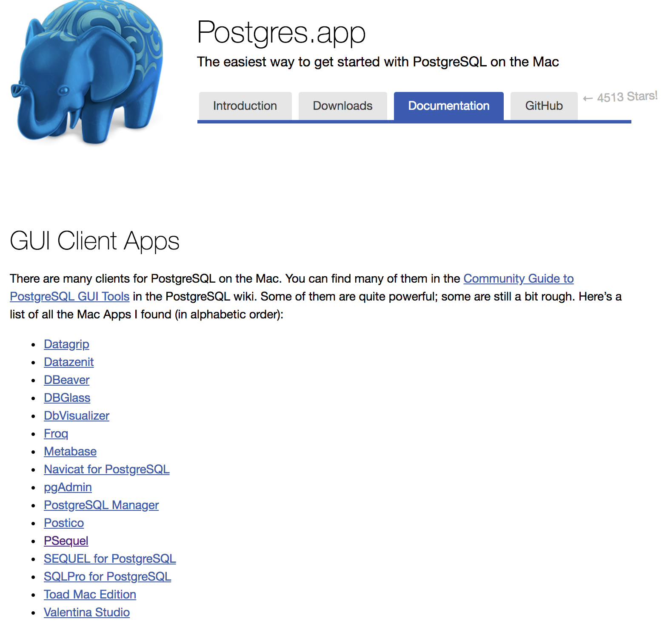
Notes:
https://postgresapp.com/documentation/gui-tools.html

Slide 22
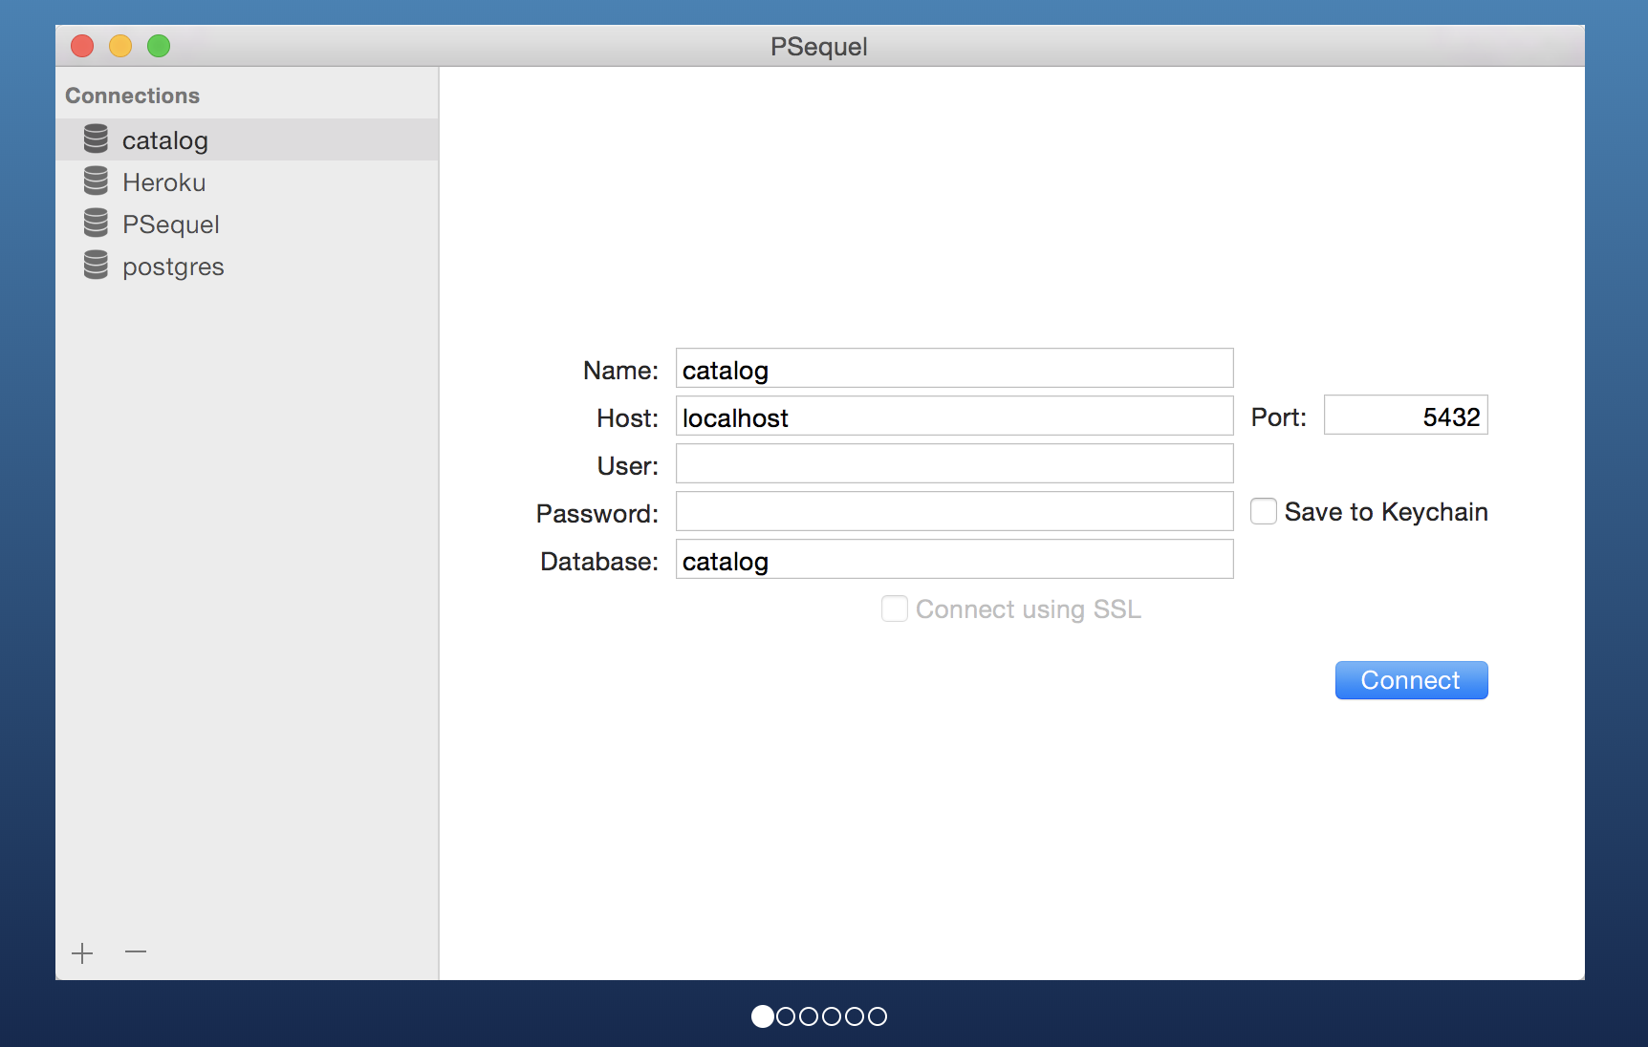
Notes:
https://postgresapp.com/documentation/gui-tools.html

Slide 23
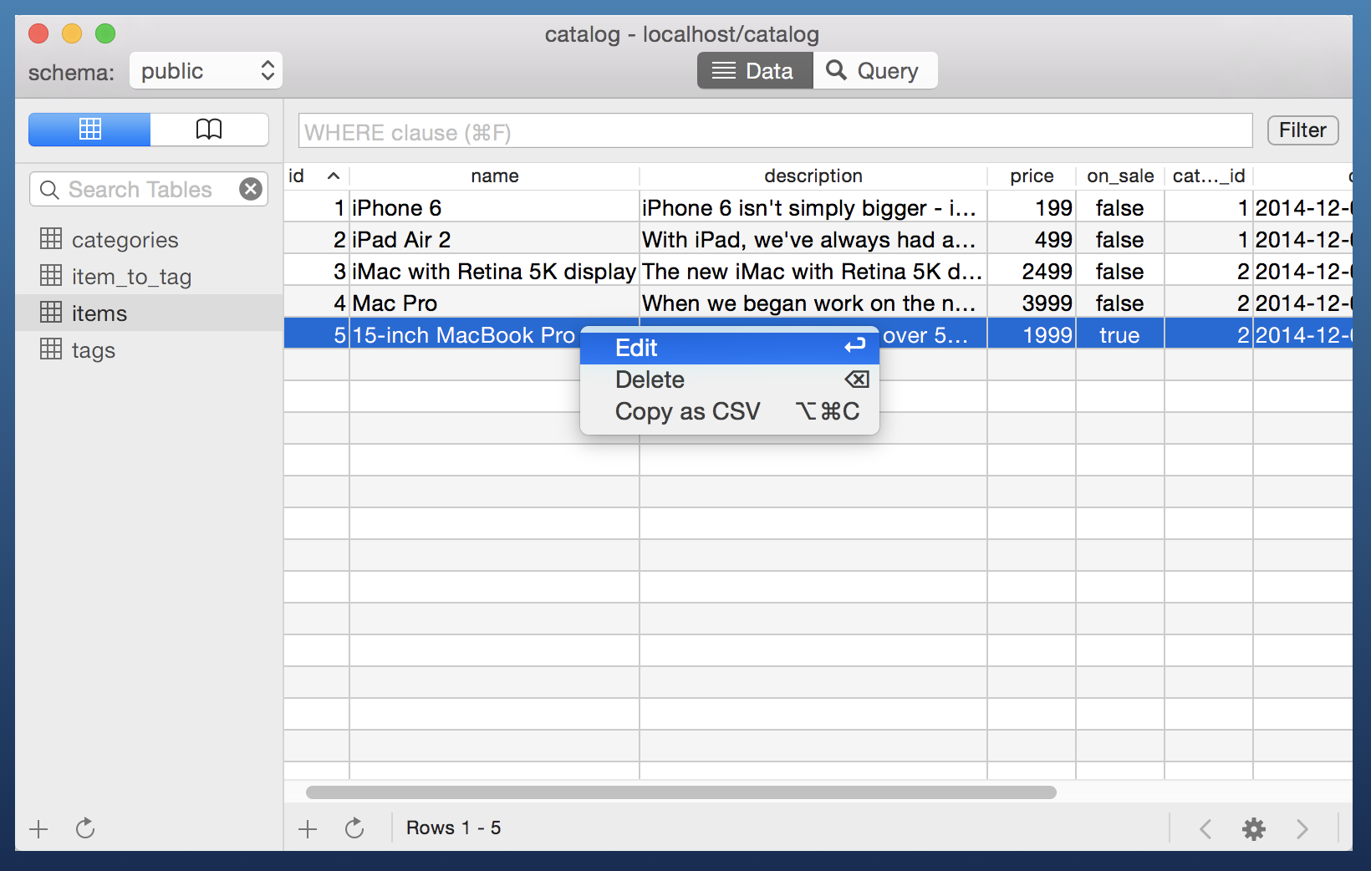
Notes:
https://postgresapp.com/documentation/gui-tools.html

